Slide 1

SDET Course
Design Patterns - Singleton

Slide 2
3 Types of Design Patterns
Creational
Singleton
Builder
Prototype
Factory Method
Abstract Factory
Structural
Adapter
Composite
Proxy
Flyweight
Bridge
Facade
Decorator
Behavioral
Strategy
Observer
Command
Memento
State
Template Method
Mediator
Chain of Responsibility
Interpreter
Visitor
Iterator

Slide 3
Agenda
Description
Diagram
Code sample (Java)
Use cases

Slide 4

Description
Introduction - The Library

Slide 5
Description
The Singleton Pattern is a design pattern that ensures a class has only one instance, and provides a global point of access to it. This pattern is particularly useful when exactly one object is needed to coordinate actions across the system.

Slide 6
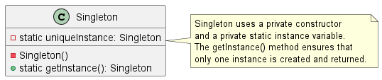
Class Diagram

Slide 7
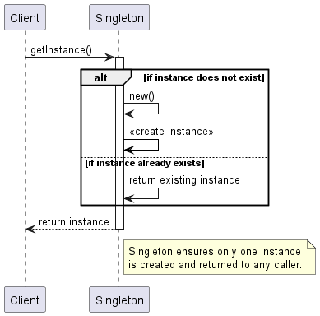
Sequence Diagram

Slide 8
Code Sample

Slide 9
Use cases
General
Global configuration file
Database connection
Logger
Global memory management
In Test Automation
WebDriver instance
Report Instance
Capabilities Instance
Connector

Slide 10
Happy Coding

